Slide 1

Newspaper Franchise
Capstone Project - The Battle of Neighborhoods

Slide 2
Background
Selecting a location for a business is one of the most important decisions in running a business.
Business decision makers need to consider different factors in finding the right location for the business, such as financial factors, market factors, and the factors that will affect their demand and revenue.
This project can help those who are planning to open a new business such as an ice-cream shop and need to find the best location for the shop in a city.

Slide 3
Business Problem
My brother wants to buy paper routes franchise in North America. The newspaper company pays by the number of neighborhood in each borough. The two major cities that has a franchise availability are New York and Toronto. My brother wants to explore and compare both cities to figure out which city will bring more cash flow.
We need the neighborhood data for Toronto and New York
We have to find the number of neighborhoods and compare
We don't know what insights we may uncover. We will dive deep into the location data and data from Foursquare.

Slide 4
Data
Extract the information about the neighborhoods of New York postal codes in and Toronto postal codes using the following website and BeautifulSoup website scraping library: https://cocl.us/new_york_dataset for New York and https://en.wikipedia.org/wiki/List_of_postal_codes_of_Canada:_M for Toronto
Transform the data into pandas dataframe
Use GeoPy Python package to get the latitude and the longitude coordinates of all the neighborhoods
Map the neighborhoods using Folium Python library
Other imported libraries are json, requests, numpy, matplotlib and sklearn
Use Foursquare API to get information about some these neighborhoods

Slide 5
Foursquare API
Looking for the following in New York City
Borough
Neighborhood
Latitude
Longitude
2. Looking for the following in Toronto
Postal Code
Borough
Neighborhood
Latitude
Longitude

Slide 6
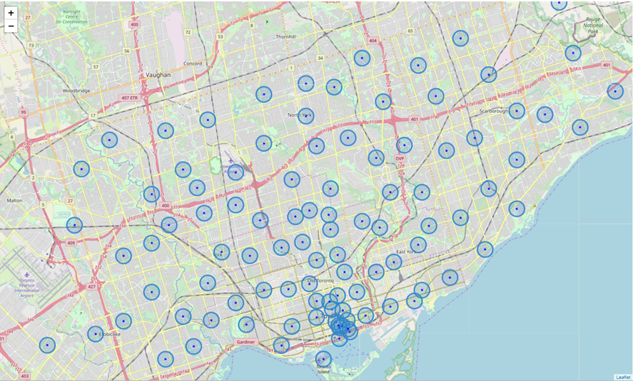
Toronto Map

Slide 7
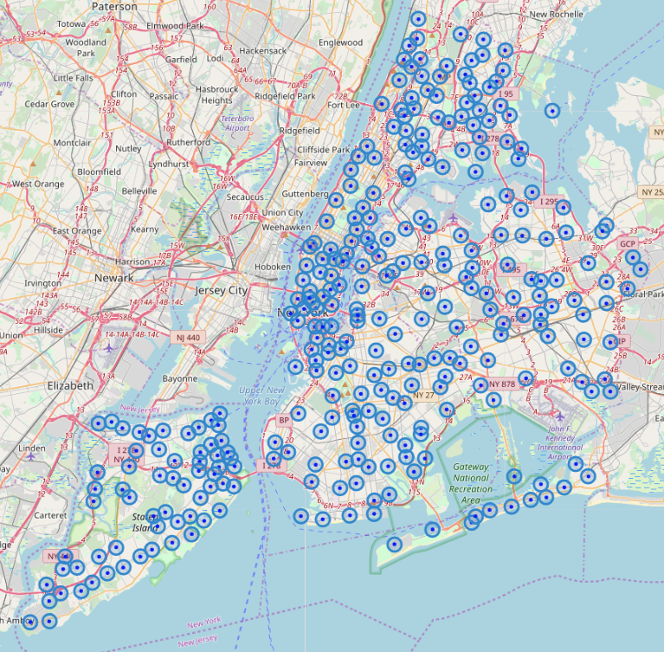
New York Map

Slide 8
Methodology
1. Collecting the data
The datasets used in this notebook are collected from two main sources namely, Wikipedia and https://cocl.us/new_york_dataset
2. Cleaning the data
Once the necessary data is collected, cleaning the data is done. The cleaning of data in this notebook is done in two phases, one for the Toronto Data and other for the New York City Data.
3. Visualization
Folium is used for this purpose. Folium generates interactive and beautiful maps, using the Latitude and Longitude we provide.
4. Machine Learning
KMeans clustering algorithm is used on the most common data frame to identify the probable clusters for different types of boroughs

Slide 9
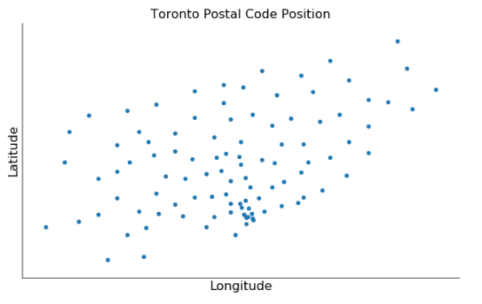
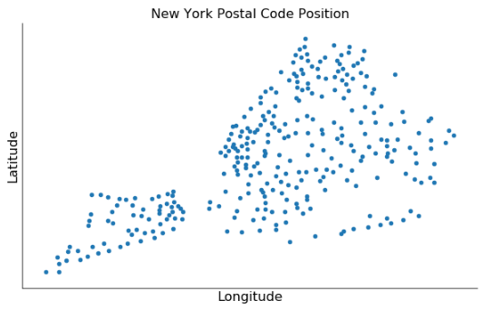

Slide 10
Results and Discussion
New York is the best city to get newspaper franchise.
It has 306 postal codes while as Toronto has 103.
It has the greatest number of postal codes which means more cash flow as compare to the Toronto
The final decision is dependent on the conversion rate of American dollar vs Canadian dollar.

Slide 11
